Slide 1
Viral Vector and Non-viral Vector

Slide 2
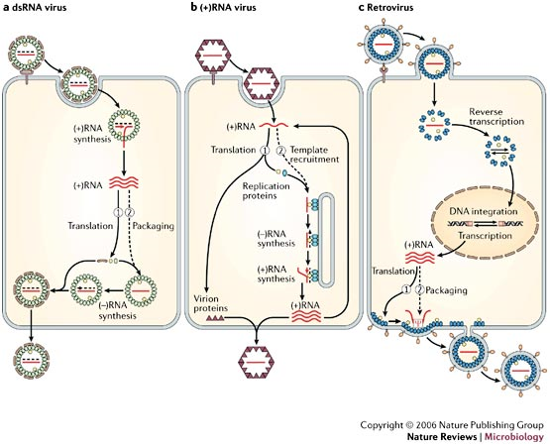
Viral Life cycle
Infection Phase
Replication Phase

Slide 3
Gene transfer strategies
Gene transfer strategies based on the delivery of tumor-specific toxins or the conversion of prodrugs into toxins may be facilitated by a process referred to as the bystander effect.
Induction of immune responses to tumor antigens or the interruption of the tumor vascular supply may require intermediate levels of gene transfer in a cell-type specific subset of the cells within, or from, a tumor.
Oncolytic viruses do not contain transgenes but are genetically engineered to allow tumor-specific viral replication resulting in cell lysis, and spread to neighboring malignant cells.

Slide 4
Bystander effect
This allows either the gene product or the converted prodrug to transport between cells, such that therapeutic efficacy may be achieved even when targeting only a fraction of the cells within a tumor.

Slide 5
Problem using viral vector
Acute toxicity from the infusion of foreign materials,
Cellular immune responses directed against the transduced cells,
Humoral immune responses against the therapeutic gene product and the potential for insertional mutagenesis by certain integrating vectors.
An additional undesirable potential effect is inadvertent transmission of vector sequences into germ cells.

Slide 6
Challenges
Use of tissue-specific promoters to drive expression of the transduced gene and the modification of the surface recognition elements of recombinant viral particles to change their cell-recognition properties.
Attempt to engineer vectors that can integrate into predetermined sites within the genome. This would avoid random integration into potentially harmful sites that might result in detrimental events.

Slide 7
Retrovirus
Retroviruses are lipid-enveloped particles comprising a homodimer of linear, positive-sense, single-stranded RNA genomes of 7 to 11 kilobases.
RNA genome is retro-transcribed into linear double-stranded DNA and integrated into the cell chromatin.
All retroviral genomes have two long terminal repeat (LTR) sequences at their ends.
LTR and neighboring sequences act in cis during viral gene expression, and packaging, retro-transcription and integration of the genome.

Slide 8
Retroviruses
The LTR sequences frame the tandem:
gag: encoding the structural proteins,
Pol: polymerases/integrases and
env : nucleic-acid and surface glycoprotein

Slide 9
Lentiviruses have a more complex genome; in addition to the gag, pol, and env genes, they encode two regulatory genes, tat and rev, essential for expression of the genome, and a variable set of accessory genes.
Spumaviruses also contain bel-1, an essential gene regulating expression of the genome, and other genes of unknown functions.

Slide 10
Case Study
Studies in non human primates did not detect pathological consequences of an exposure to an amphotropic replication-competent retrovirus (RCR).
Infusion of vector replication-competent viral vectors contain all necessary genes for virion synthesis, and continue to propagate themselves once infection occurs.
Serum lacked antibodies reactive with viral proteins and contained 10⁴ to 10⁵ infectious virus particles per ml.

Slide 11
Terms
Amphotropic:
An oncornavirus that does not produce disease in its natural host, but does replicate in tissue culture cells of the host species and in cells from other species.
RCR:
Replication competent retrovirus
Having all the machinery required for replication

Slide 12
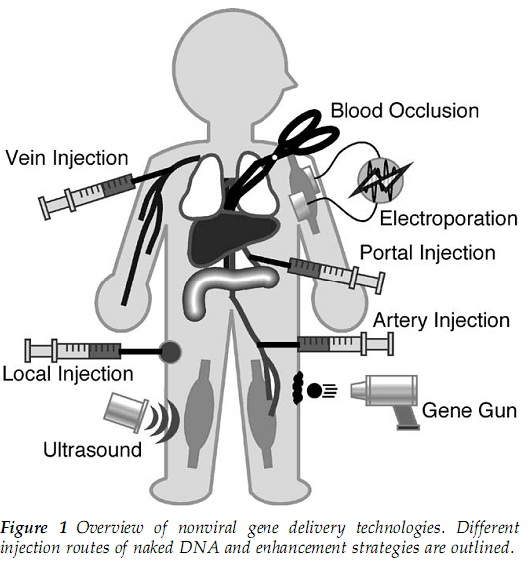
Non-Viral Vectors

Slide 13
Assignment - 1
Gene Therapy protein folding
Search any article having experiment performed on human or other primates for the treatment of certain disorder.
Use sciencedirect.com and then same article you can search in Google to check availability
Send me the pdf link of article from science direct. (if not available on Google)
Provide at least link of two article.
Article request: Till 18 Jan 2011, 12 PM.
Submission date: 22 Jan 2011, 12PM.

Slide 14
Slide
Introduction-1pg (1Mark)
Practical Approach-2pg(1Mark)
Thinking behind the project (Scientific perspective)-1pg (2 marks)
Conclusion -1pg (1 mark)
Evaluation:
Two marks for article selection (you have to choose those article in which gene therapy has been performed in in vivo situation)

Slide 15
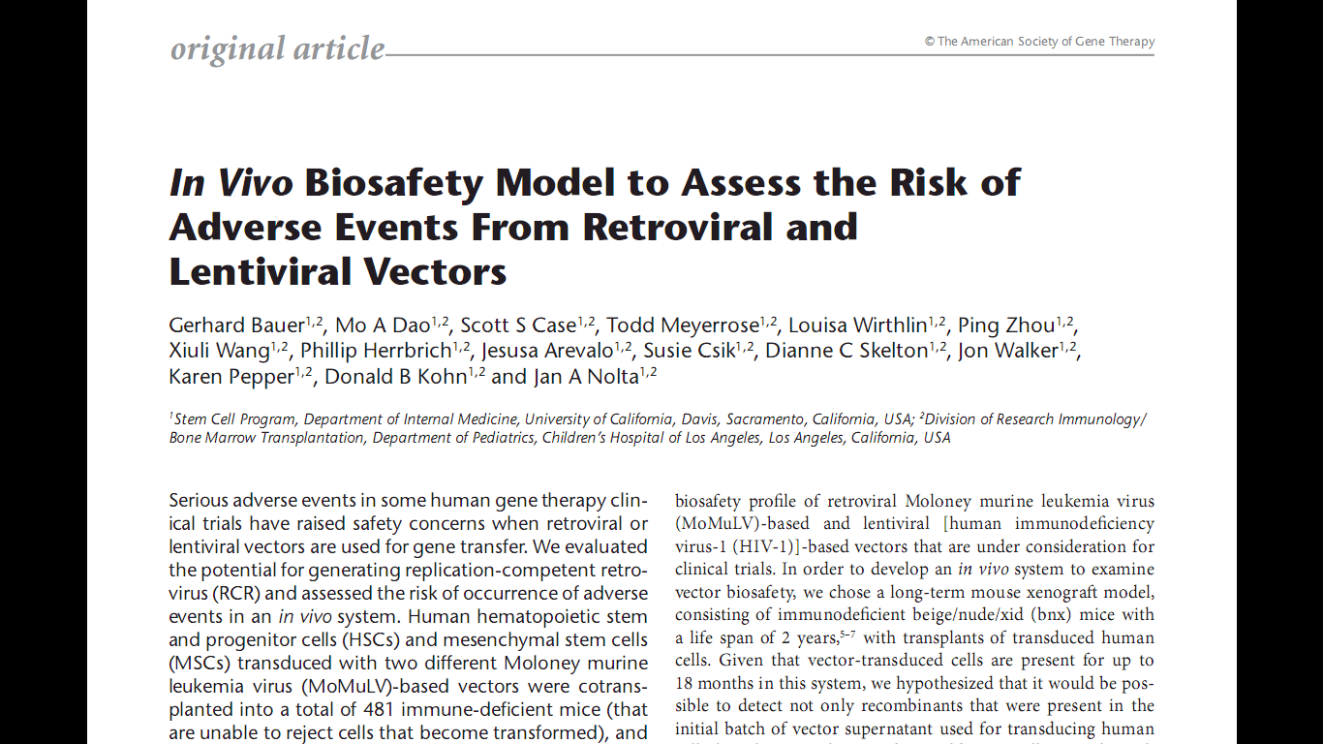

Slide 16
Reference
Paul Ahlquist (2006).Parallels among positive-strand RNA viruses, reverse-transcribing viruses and double-stranded RNA viruses. Nature Reviews Microbiology, 4, 371-382.
Vanin, E.F., et al. (1994). Characterization of Replication-Competent Retroviruses from Nonhuman Primates with Virus-Induced T-Cell Lymphomas and Observations Regarding the Mechanism of Oncogenesis. Journal of Virology, 68 (7) p. 4241-4250.
Bauer, G., et al. (2008). In Vivo Biosafety Model to Assess the Risk of Adverse Events From Retroviral and Lentiviral Vectors. The American Society of Gene Therapy, 16(7),1308–1315.
Niidome, T. and L Huang, L., (2002). Gene Therapy Progress and Prospects: Nonviral vectors. Gene Therapy, 9, 1647–1652.

